Slide 1
Divide & Conquer: Efficient Java for the multi-core world
Velmurugan Periasamy
Sunil Mundluri
VeriSign, Inc.

Slide 2
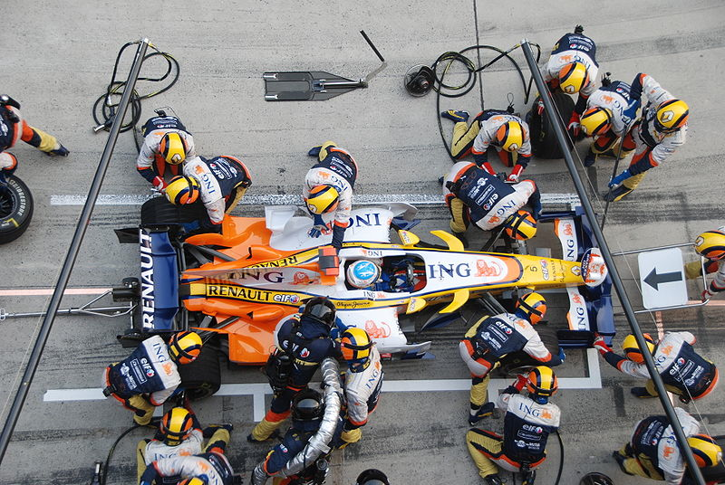
About us
Java Performance Engineers
Working at Verisign
Source :http://en.wikipedia.org/wiki/File:Alonso_Renault_Pitstop_Chinese_GP_2008.jpg

Slide 3

Agenda
Problem Statement
Efficiently leverage hardware
Fine grained Parallelism
Fork-Join Framework
Java 7 Implementation
Examples / Demo

Slide 4

Where to look for performance improvements going forward?

Slide 5
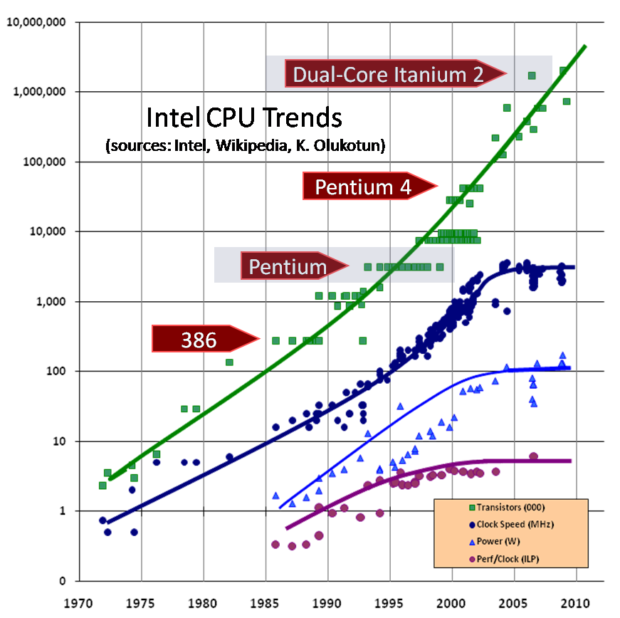
Current Trend
No more increase in clock speed
Increasing number of cores
Source: http://www.gotw.ca/publications/concurrency-ddj.htm

Slide 6

Need to build applications that can efficiently utilize hardware resources (multiple cores)
Hint: More parallelism

Slide 7
Background
Improving application efficiency with single CPU
Improve end user perceived performance (i.e. hide latency) by asynchronously performing some work (using threads)

Slide 8
Background
Keeping up application efficiency with multiple CPUs
Concurrent user requests (coarse grained parallelism) – e.g. web servers, application servers.
Thread pools for scheduling tasks

Slide 9
Background
How to continue the efficient utilization with many cores?
Concurrent user requests may not be enough to keep CPUs busy
Need more parallelism

Slide 10
Let’s clarify some terms
Concurrency ≠ Parallelism
Multithreading ≠ Parallelism

Slide 11
Few definitions
Concurrency: A condition that exists when at least two threads are making progress
Parallelism: A condition that arises when at least two threads are executing simultaneously
Multithreading: Allows access to two or more threads. Execution occurs in more than one thread of control, using parallel or concurrent processing
Source: Sun’s Multithreaded Programming Guide
http://dlc.sun.com/pdf/816-5137/816-5137.pdf

Slide 12
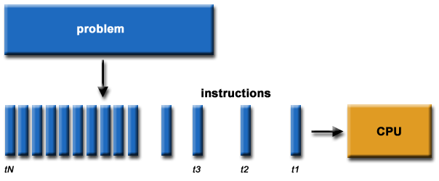
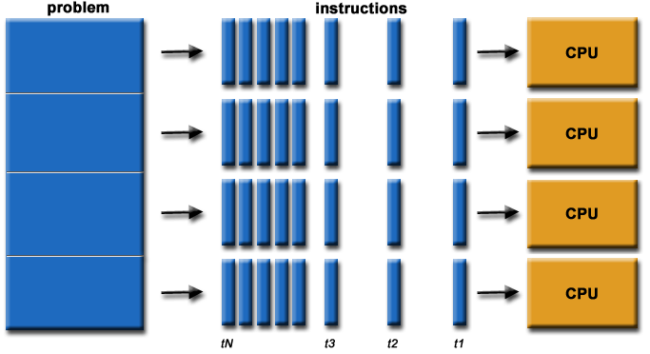
Concurrency vs Parallelism

Slide 13
Need to build applications that can efficiently utilize hardware resources (multiple cores)

Slide 14
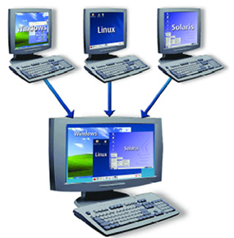
Possibilities for efficient utilization
Server Virtualization

Slide 15
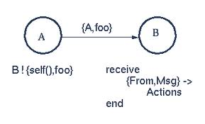
Possibilities for efficient utilization
Other approaches towards concurrency
Message passing concurrency approach implemented by languages like Erlang, Scala, Haskell (Thousands of light weight processes)
Software Transactional Memory (e.g. Clojure)

Slide 16

Possibilities for efficient utilization
fine grained parallelism

Slide 17
Fine Grained Parallelism
Focus on tasks rather than threading
Find appropriate tasks that can be efficiently parallelized
The finer the granularity, the better the performance boost
Proper functional decomposition is key

Slide 18
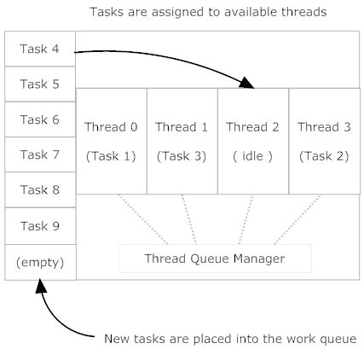
Fine Grained Parallelism at work

Slide 19
Where to look for Fine Grained Parallelism?
CPU-intensive operations good candidates
Sorting, searching, filtering, aggregation operations more suitable to parallelization
Network servers which spend a great deal of time waiting on network I/O may not offer more value for parallelization
Where NOT?

Slide 20
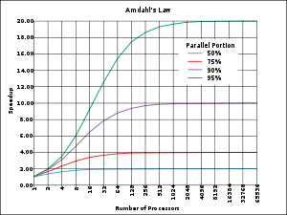

Amdahl’s Law
P = proportion of a program that can be made parallel
(1 − P) = proportion that cannot be parallelized (remains serial)
Maximum speedup that can be achieved with N processors is given by below formula
For example
Let P be 90%, (1 − P) is 10%
In this case problem can be sped up by a maximum of a factor of 10
No matter how large N is (i.e. #processors/cores)
Source: http://en.wikipedia.org/wiki/Amdahl%27s_law

Slide 21
Fine Grained Parallelism Challenges
How to decompose the application into units of work that can be executed in parallel?
How to properly scale the parallelism?
As per Amdahl’s law, look to maximize the parallelizable portion of the application
Need new techniques, frameworks & libraries

Slide 22
Divide-and-Conquer
Much before computers
Basic example :
How mail gets delivered

Slide 23
Divide-and-Conquer algorithm
Recursively break down the problem into sub problems
Combine the solutions to sub-problems to arrive at final result

Slide 24
How does this help us in achieving fine grained parallelism?

Slide 25

Fork-Join framework
Source: http://www.flickr.com/photos/volundur/174358956/

Slide 26
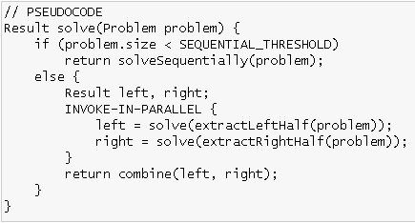
Fork Join Framework
Parallel version of Divide and Conquer
Recursively break down the problem into sub problems
Solve the sub problems in parallel
Combine the solutions to sub-problems to arrive at final result
General Form

Slide 27
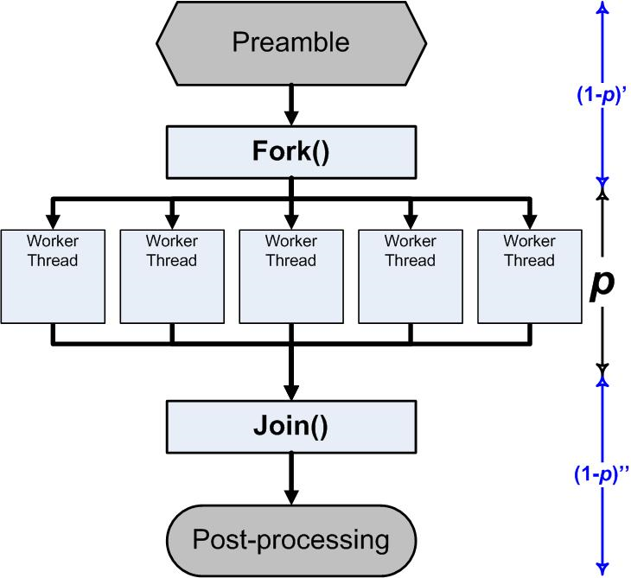
Fork-Join framework
Source: http://blogs.msdn.com/b/ddperf/archive/2009/04/29/parallel-scalability-isn-t-child-s-play-part-2-amdahl-s-law-vs-gunther-s-law.aspx

Slide 28
Java library for Fork–Join framework
Started with JSR 166 efforts
JDK 7 includes it in java.util.concurrent
Can be used with JDK 6.
Download jsr166y package maintained by Doug Lea
http://gee.cs.oswego.edu/dl/concurrency-interest/

Slide 29
Java library for Fork–Join framework
ForkJoinPool
Executor service for running fork-join tasks
Several styles of ForkJoinTasks
RecursiveAction
RecursiveTask

Slide 30
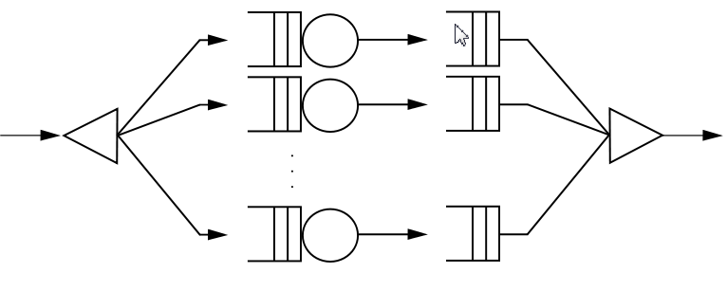
Fork-Join framework
Executing a task means…
Create two or more new subtasks (fork)
Suspend the current task until the new tasks complete (join)
Invoke-in-parallel operation is key
A portable way to express parallelizable algorithm

Slide 31
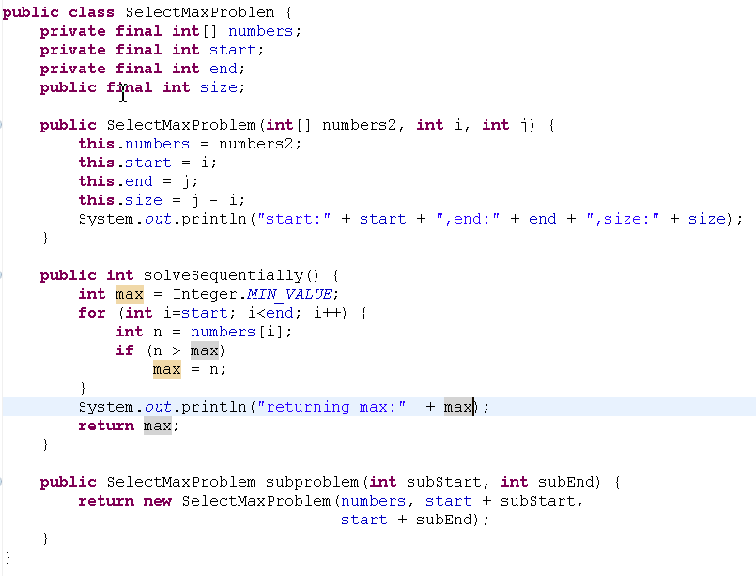
Selecting a max number
Sequential algorithm

Slide 32
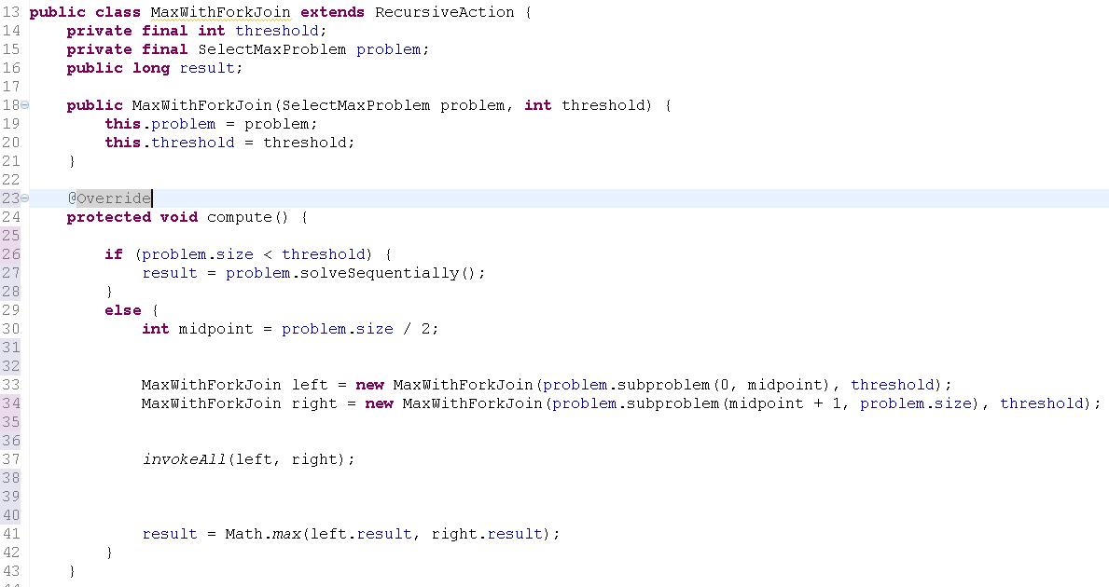
Selecting max with Fork-Join framework
A Fork-Join Task
Solve sequentially if problem is small
Otherwise Create sub tasks & Fork
Join the results

Slide 33
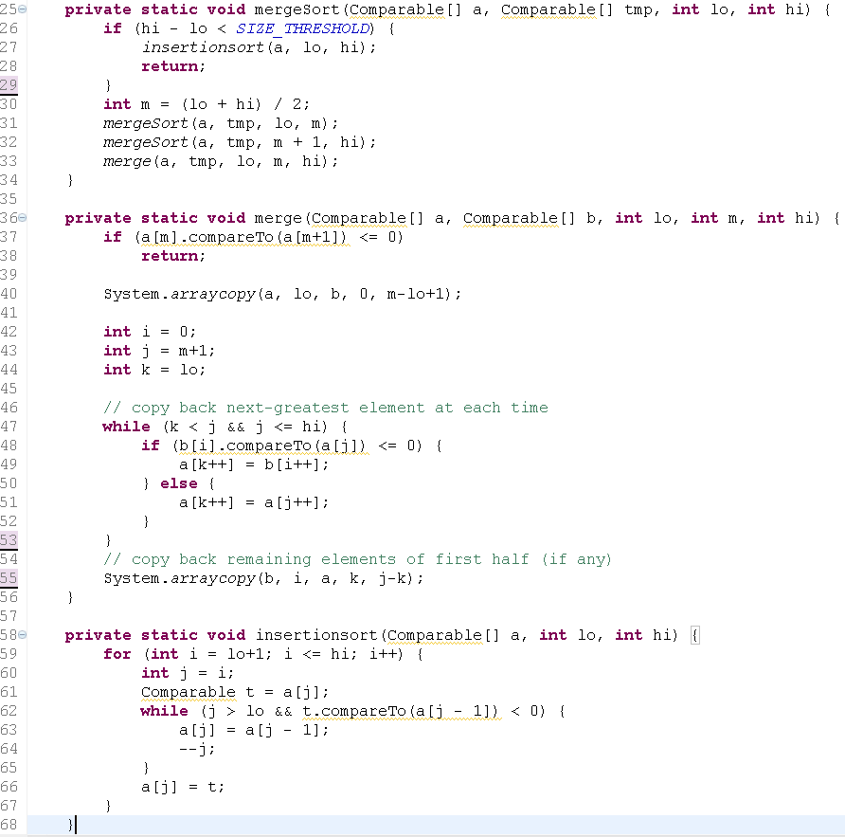
Another example – Merge Sort
Recursive algorithm

Slide 34
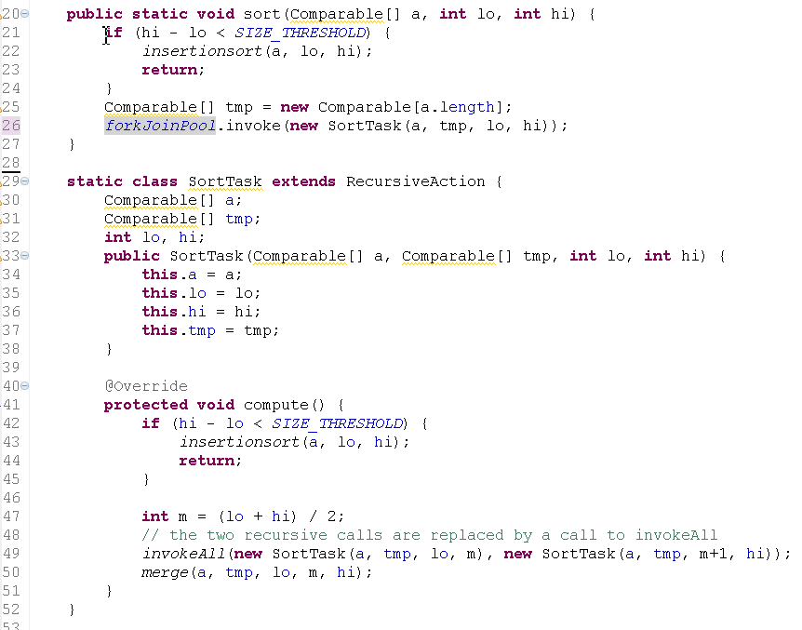
Merge Sort with Fork-Join framework
This class replaces the recursive method
Fork & Join

Slide 35
Fork Join Task Demo

Slide 36
Fork-Join framework implementation
Basic threads (Thread.start() , Thread.join())
May require more threads than VM can support
Conventional thread pools
Could run into thread starvation deadlock as fork join tasks spend much of the time waiting for other tasks
ForkJoinPool is an optimized thread pool executor (for fork-join tasks)

Slide 37
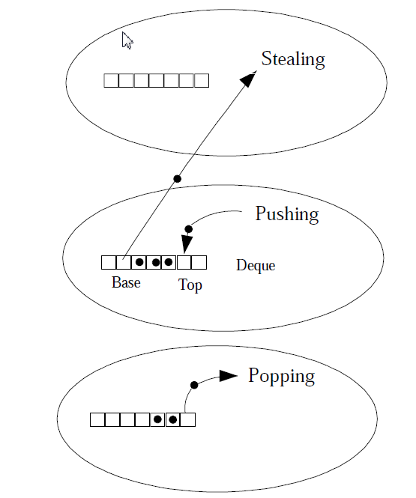
Fork-Join framework implementation
Limited number of worker threads
A private double-ended work queue (deque) for each worker
When forking, push new task at the head of deque
When waiting or idle, pop a task off the head of deque and executes it (instead of sleeping)
If own deque is empty, steal an element off the tail of the deque of another randomly chosen worker
Source: “A Java Fork/Join Framework” Paper by Doug Lea

Slide 38

ForkJoinTask as is could improve performance…
However some boilerplate work is still needed. Is there a better way?
i.e. declarative specification of parallelization
There is a better way

Slide 39
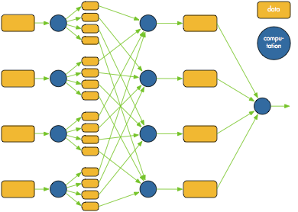
Options for Transparent Parallelism
ParallelArray
ForkJoinPool with an array
Versions for primitives and objects
Provide parallel aggregate operations
Can be used on JDK 6+ with extra166y package from http://gee.cs.oswego.edu/dl/concurrency-interest/

Slide 40
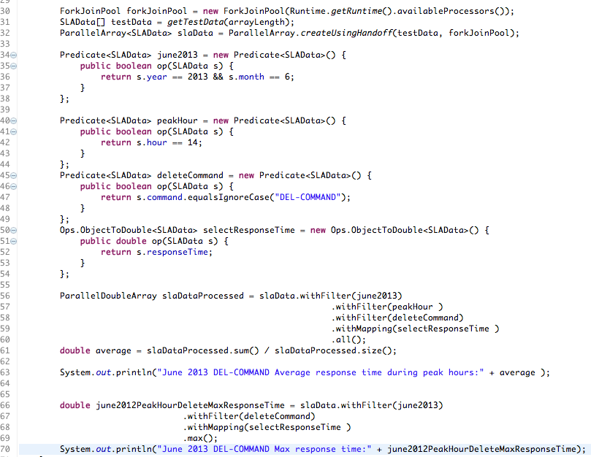
Example: ParallelArray Operations
ParallelArray created with ForkJoinPool
A filter operation
A map operation
SQL like.. Batches operations in a single parallel step
Select max is a single step

Slide 41
Options for Transparent Parallelism
Features in JDK8
Parallel utility methods in java.util.Arrays class
Many types of parallelSort method available
Parallel set/prefix operations
Bulk data operations for Collections
Stream interface to support “Pipes and Filter” pattern (with parallel option)
a.k.a “filter/map/reduce for Java”
Lambda expressions (JSR-335)
Closure – “Anonymous function expression”
Concise Code
Functional aspect

Slide 42
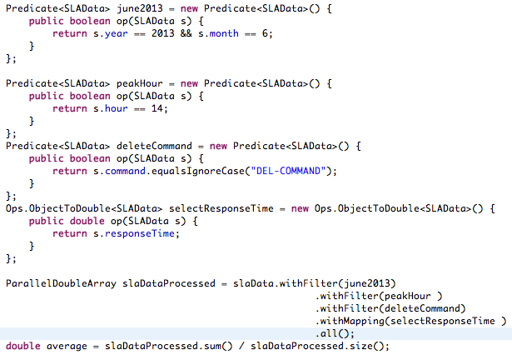
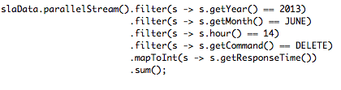
Lambda’s make life easier..
With Lambda’s

Slide 43
Fork-Join and Map-Reduce
 | Fork-Join | Map-Reduce
Processing on | Cores on a single compute node | Independent compute nodes
Division of tasks | Dynamic | Decided at start-up
Inter-task communication | Allowed | No
Task redistribution | Work-stealing | Speculative execution
When to use | Data size that can be handled in a node | Big Data
Speed-up | Good speed-up according to #cores, works with decent size data | Scales incredibly well for huge data sets
Source: http://www.macs.hw.ac.uk/cs/techreps/docs/files/HW-MACS-TR-0096.pdf

Slide 44
Demo Transparent Parallelism

Slide 45

Re-cap
To leverage multi-cores, find finer-grained sources of parallelism
Aggregate data operations are best suited
Fork-Join (in JDK 7.0) offers a nice way to "portably express" a parallelizable algorithm.
Many exciting features coming in JDK8 to enable Parallelism (transparently)

Slide 46
References
http://gee.cs.oswego.edu/dl/concurrency-interest/
http://jcp.org/en/jsr/detail?id=166
http://www.ibm.com/developerworks/java/library/j-jtp11137.html
Brian Goetz’s JavaOne presentation
http://www.gotw.ca/publications/concurrency-ddj.htm
http://software.intel.com/en-us/articles/maximizing-performance-with-fine-grained-parallelism/
http://docs.sun.com/app/docs/doc/816-5137/mtintro-75924?a=view
http://en.wikipedia.org/wiki/Amdahl%27s_law
http://stackoverflow.com/questions/1050222/concurrency-vs-parallelism-what-is-the-difference
http://www.danielmoth.com/Blog/Fine-Grained-Parallelism.aspx
http://en.wikipedia.org/wiki/Software_transactional_memory
http://blog.quibb.org/2010/03/jsr-166-the-java-forkjoin-framework/
http://www.oracle.com/technetwork/articles/java/fork-join-422606.html
http://www.macs.hw.ac.uk/cs/techreps/docs/files/HW-MACS-TR-0096.pdf
http://www.javacodegeeks.com/2013/04/arrays-sort-versus-arrays-parallelsort.html
http://www.lambdafaq.org/
http://ttux.net/post/java-8-new-features-release-performance-code/

Slide 47
Copyright © 2013 VeriSign, Inc. All rights reserved. The VERISIGN word mark, the Verisign logo, and other Verisign trademarks, service marks, and designs that may appear herein are registered or unregistered trademarks or service marks of VeriSign, Inc., and its subsidiaries in the United States and foreign countries. Verisign has made efforts to ensure the accuracy and completeness of the information in this document. However, Verisign makes no warranties of any kind (whether express, implied or statutory) with respect to the information contained herein. Verisign assumes no liability to any party for any loss or damage (whether direct or indirect) caused by any errors, omissions, or statements of any kind contained in this document. Further, Verisign assumes no liability arising from the application or use of the products, services, or materials described or referenced herein and specifically disclaims any representation that any such products, services, or materials do not infringe upon any existing or future intellectual property rights.

